Slide 1
Brought to you by the BAIC

Slide 2
Of Course, We Need a RepoRt
I Was Just Ending The Elicitation Session When I Heard Those Dreaded Words
Jim Milligan and Randy Babb
March 8, 2017

Slide 3
Why These Words Cause Panic
Report Requirements Only Tangentially Relate To Project Requirements
Project Requirements and Analysis Are About Adding Business Value
What Value Does This Project Bring To the Business?
How Will the Business Realize This Value?
What Gaps Must Be Filled To Realize This Value?
All Good Background Information But These Are Not Report Requirements
Report R&A Is About Telling the Story Of Is the Value Being Realized
Report Requirement Elicitation And Analysis Require Additional Time
Do Not Get Blindsided
Determine As Early As Possible What The Reporting Needs Will Be And Add TIme

Slide 4
It ain’T Always Easy
Some Types Of Projects Inherently Require Lots Of Additional Time
Replacing Entrenched Legacy Systems
Multiple Reports With Only Slight Differences in Data Or Format
Stakeholders Will Say They Cannot Live Without Their Version
Consolidating Multiple Duplicate Systems
Many Different Reports With Same Purpose
Stakeholders Will Claim Their Version Is Superior
Don’t Waste Time Fretting Over Which Existing Report Is Best
Get Stakeholder To Focus On Improvements
How Can We Make This Report Be More Valuable For You?
What Did You Always Want To Do With This Report But Never Could?

Slide 5
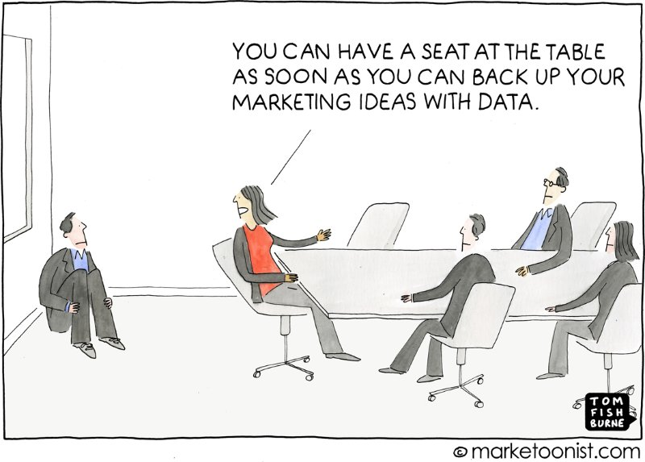
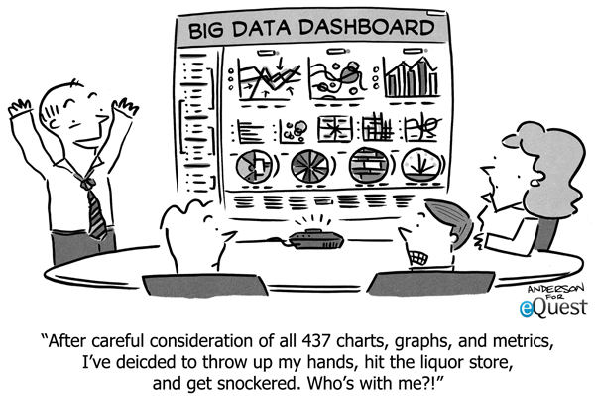
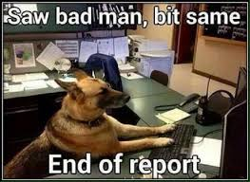
Different Strokes For Different Folks
Reports Need To Tell An Actionable Story To Stakeholders
Different Stakeholders Need Differing Presentations To Understand Story
Some Need Just the Cliff Notes
Some Need Just Problem Statement and Conclusion
Some Need All the Details

Slide 6
Different Strokes For Different Folks
Stakeholders Have Different Communication Styles
The ‘DISC’ Model
D – Driver
Focus On ‘Getting The Job Done’, Make Decisions Quickly Sometime Without All Facts
Think C Level, Entrepreneurs
Report Should Make Points Clearly, Succinctly and Quickly
Think Pie Charts, Stop Lights
Report Should Not Be Too Detailed. They Will Feel It To Be a Waste of Time
I – Influence
Motivate Others, Develop Creative Solutions But May Overlook Details
Salespeople, Planners
Report Should Give the Big Picture
Report Should Not Dwell On Details and Facts. (Put These In the Appendix)

Slide 7
Different Strokes For Different Folks
Stakeholders Have Different Communication Styles
S – Steadiness
Dependable Workers, People-oriented, May Avoid Issues Until They Are Problems
Civil Servants
Report Should Present Information Deliberately and Clearly In Terms Of Benefits
Report Should Not Dive Straight Into the Details
C - Compliance
Organized and Detail Oriented, May Take Long Time To Make A Decision
Analysts, Accountants
Report Should Present Information In Logical Fashion With Facts And Figures
Report Should Not Force Rapid Decision

Slide 8
Stakeholder Needs
Stakeholders Will Want To Talk About Data Fields and Format
All the Data and All the Formats They Think They Might Ever Need
Don't Fall Into This Trap!
Data and Format Requirements Come Later
For Each Stakeholder, First Determine:
How They Will Use A Report?
What Decisions Will They Make Based On a Report?
What Actions Will They Take Based On a Report?
How Long Will They Retain the Report?
Never Ask Who Will See the Report? You Have Your Reader.
Unless You Are Looking For More Stakeholders
These Requirements Should Dictate the Report Contents
Now We Can Talk Data Requirements

Slide 9
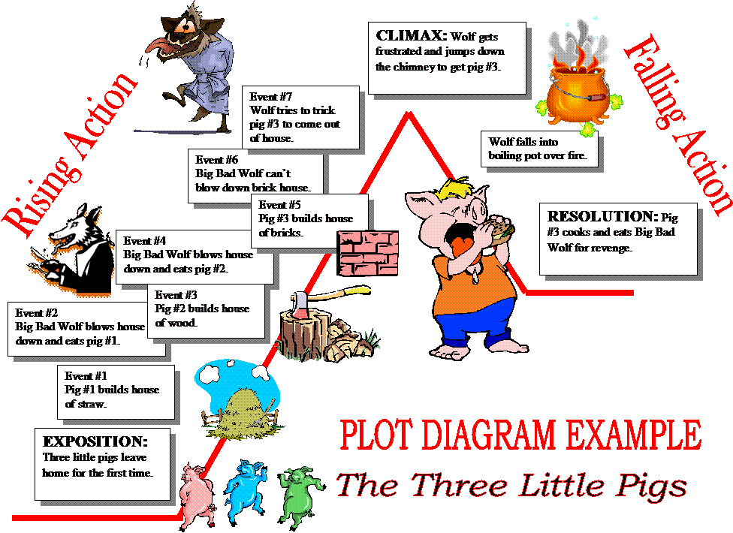
Data
You have the plot now you need the characters

Slide 10
Support Business Value
You have the PLOT outline
Business value of the report
Not same as business value on which you are reporting
Now you need the CHARACTERS
Can't tell a riveting story without interesting characters
Our point of view data are the characters
Data drives every decision point on a report
What is next?
What characters do you need?
How do you know you need them?
Are they stars or supporting characters?
Involving others

Slide 11
What characters do you need?
Analysis - Lonely are the Brave
Business partner gave you the plot
BI developers will publish the story
You have to define the characters
You may mock-up rough draft of what report could look like
Identify needed Characters
Review Solution Requirements for data requirements
Compare to information for report
Can you relate a data element to every major information point?
Do you have what you need?

Slide 12
How do you know you need them?
Where do the characters live?
Formatted -Batch –formatted databases usually company controlled
Streaming -- Social media -- unformatted video, audio, text
Response Repository -- communication between systems with sender receiver (IBM MQ Series)
Big Data -- gigantic data lake may be formatted, unformatted, or combination
Do you have too many characters?
Pare down characters that clutter the scenery
They may be interesting, important in the past, possible future need
Keep a focus on the plot for this report
Removing extraneous characters highlights information for clear story
Always honor the plot – don’t create a trilogy when a short story suffices

Slide 13
Major or supporting characters?
Ensure hierarchy
Ask yourself these questions
Do all the supporting characters tie to a major characters?
Do I have any major characters with no support?
All detail data should roll up to information supporting a decision
Some characters may need witness protection
PCI - Payment Card Information
Display last 4 digits of Credit Card Number or SSN
Don't put on report - ask why this detail needs to be displayed
HIPAA – Health Information Portability and Accountability Act
Identifies how data can be shared
PHI – identifies what is Protected Health Information
SOX - Sarbanes Oxley – identifies financial information and disclosure rules
Careful to mask individual that could combine to identify someone

Slide 14
Involve others
Who do you need to involve?
May need data scientist if Big Streaming data
Definitely need Developer to move or change data
Usually known as ETL - Extract Transform Load requirements
BI Developer to turn your mock-up into reality
When do you need to involve them?
Analysis
Confirm the characters exist and where they live
What makeover is needed
Best reporting tool for job
Delivery
Advice on best presentation
Build prototypes
Build final

Slide 15
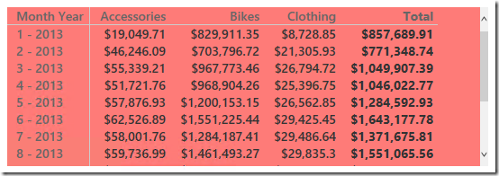
Do They really need a report?
Reports Imply; Point-In-Time, Fixed Format, Snapshot of Business
External vs Internal Focus
Annual Report
Regulatory
Sarbanes Oxley
Analytical
Sales By Region By Salesperson
Routine
Monthly Inventory
Special
Progress Reports

Slide 16
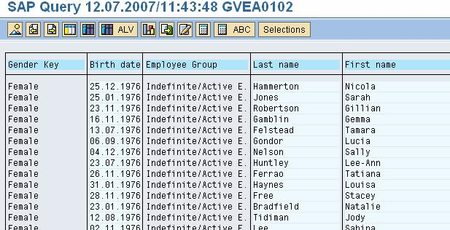
Do They really need a report?
Ad Hoc Reports Imply; User Defined, Created For Data Manipulation
What Filters Will Stakeholder Need?
Ability To Include Or Exclude Data From Report
How Complex Are the Filtering Criteria?
AND, OR, =, >, <,
XOR, NOT
What Sorting Capability Will Stakeholder Need?
How Many Sorting Levels?
What Export Capability Will Stakeholder Need?
Microsoft Excel (.xlsx)
Comma Separated Variable (.csv)

Slide 17
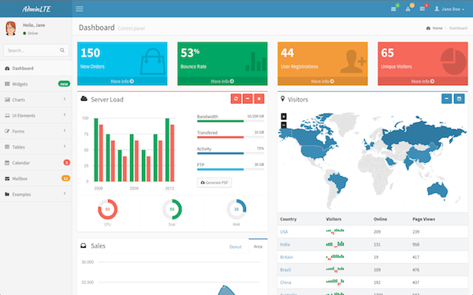
Do They really need a report?
Dashboards Imply; Near Real Time, At-a-Glance View of KPIs
Strategic
High Level, Quick Overview To Monitor the Health Of the Business
Usually Tailored To the Level Of the Management Level Of the Stakeholder
Analytical
Typically Present Comparisons
Historical Performance
Typically Permit Drilldown
Operational
Typically Geared To Alerting Or Quickly Drawing Attention To Specific Details
How Will Dashboard Be Accessed?
Standalone Application, Web Browser, Desktop Application (Widgets)

Slide 18
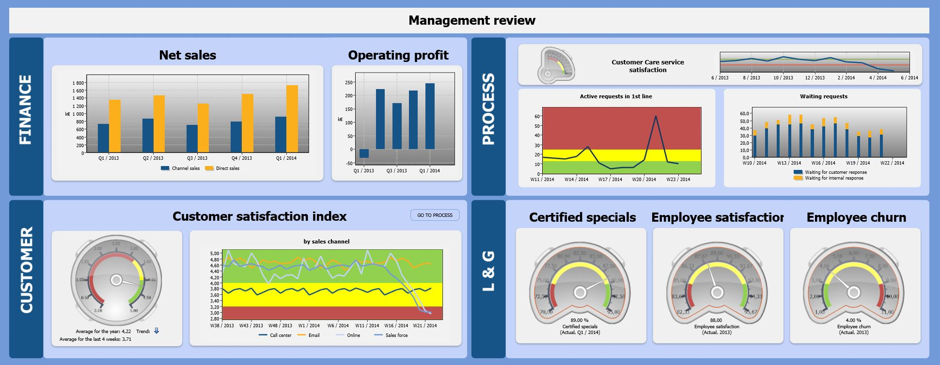
Do They really need a report?
Scorecards Imply; Point-in-Time Comparison To Strategy
May Be Called Balanced Scorecard
Show Mixture Of Financial and Non-financial Measures Compared To ‘Targets’
Focus On Small Number Key Measures
Show Perspectives
Grouping High Level Strategic Areas
Show Objectives
Verb-Noun Phrases From Strategic Plan
Show Metrics and KPIs
Show Stoplight Indicators – Red, Yellow, Green
How Will Scoreboard Be Presented?
Printed Report, On-line (Web Browser), Desktop Application

Slide 19
Presentation
Tailor design to audience
Daily operations update – graphic novel
C-Level Corporate reports – full blown hard back leather bound
Depends on business value
Match format and story
Don’t bury your story in the wrong format
Avoid using all the cool options
Think simple
Analyze your stakeholder needs
Benefits of Layering
Summary → Detail
Detail → Summary
Drill or Tab
Edit and Revise as needed

Slide 20
No Report Is Trivial
Stakeholders Need Your Skills To Get Value Out Of Reports
Requirements Elicitation and Analysis Are Key
Give Yourself Time To Do The Job Right
Reports Tell An Actionable Story
In the Communication Style the Reader Can Understand
In a Format the Reader Can Take Action On

Slide 21
The Never Ending Story
Reports provide information to make decision or track performance
Analysis is the effort needed to make a report meaningful and useful
Either can exist alone – but truly better if working in tandem
A good report like a good story cannot exist without some analytical thought about business value (Plot), data needed (Characters) , and audience format (Publishing)

Slide 22
Appendix
C Level – Corporate Executives; President, CFO, CIO, CTO
ETL – Extract Transform Load – requirements for tools that pull data from source, change the data to meet report requirements, and put the data into the report repository
Transform – alter the source data to meet your reporting need
Tableau – allows for instantaneous insight by transforming data into visually appealing interactive visualizations called dashboards. Has ability to pull in data from disparate sources from complex databases to spreadsheets.
Drill down – access detailed data at a lower level of organization
Drill up – zoom out from detail data to a higher level of information
BI – Business Intelligence refers to practices and techniques that transform raw data into information useful for decisions
Big Data – massive collection of unorganized digital data
Streaming Data – generated continuously from multiple sources received simultaneously in small sizes

Slide 23
Appendix
PCI – Payment Card Information standard mandates security standards for organizations that handle branded credit cards. It controls how customer data can be collected, stored, and transmitted. This link opens the PCI Data Security Standards website
HIPAA – Health Insurance Portability a Accountability Act is a 1996 Federal law that restricts access to individuals’ private medical information. This link opens the U.S. Department of Health & Human Services Health Information Privacy web site.
SOX – Sarbanes-Oxley Act of 2002 is a Federal Law setting financial reporting requirements for publicly traded companies with some rules applying to privately held companies. This link opens a guide to the Sarbanes-Oxley Act web site.

Slide 24
Appendix
For Existing Reports
How Can We Make This Report More Valuable For You?
What Did You Always Want To Do With This Report But Never Could?
Ask Stakeholders
How Will You Use This Report?
What Decisions Will You Make Based On This Report?
What Actions Will You Take Based On This Report?
How Long Will You Retain A Copy Of This Report?

Slide 25
Appendix
When Trying To Tell the Story In the Report
What Characters Do You Need?
How Do You Know You Need Them?
Are They Stars or Supporting Characters?
Can You Relate a Data Element To Every Major Information Point?

Slide 26
Appendix
Finding the Data For the Report
Do You Have What You Need?
Where Does the Data Live?
Do You Have Too Many Data Elements?
Do All the Supporting Data Elements Tie to a Major Data Elements?
Do You Have Any Major Data Elements With No Supporting Data Elements?

Slide 27
Appendix
HELP!
Who Do You Need To Involve?
When Do You Need To Involve Them?
What Is the Best Report Format To Tell the Story?
A Report?
An Ad Hoc Report?
What Filters Will Stakeholder Need?
What Sorting Capability Will Stakeholder Need?
How Many Sorting Levels?
What Export Capability Will Stakeholder Need?
A Dashboard?
A Scorecard?

Slide 28
What’s On your mind?

