Slide 1
Kanban/Scrum: A BA’s Foot in Both Worlds
Drew Washburn – Sr. Business Analyst
IIBA Columbus Chapter – June Meeting

Slide 2
Drew Washburn
Senior Business Analyst
Safelite Solutions

Slide 3
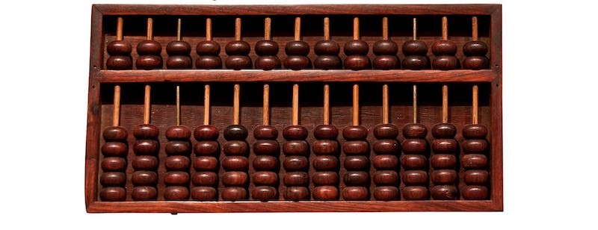
Notes:
Let me put to rest a rumor right now!
There is absolutely NO truth to the statement that this was my first computer!

Slide 4
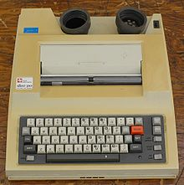
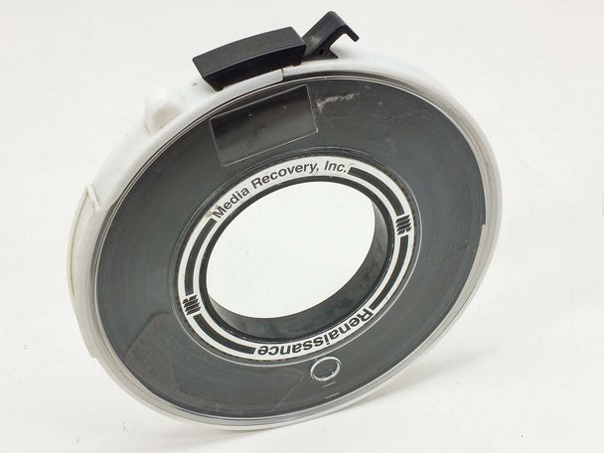
Notes:
I’m not saying how long I’ve been working, but these were ‘state of the art’ at the time!
I did, spend time as a architect and developer and later as a DBA. At that time, the concept of Business Analyst did not yet exists; developers determined requirements on their own.

Slide 5
Notes:
Here’s where all I have worked. Not in any order and some overlap since they are consulting companies. Some don’t exist anymore.

Slide 6
Intro to Agile
Notes:
Teaching a class on Agile Basics.

Slide 7
What about me?
Notes:
Who are you and why are you interrupting me!

Slide 8
You can call me
.
.
.
.
Jack!
Notes:
That answers who you are, but why did you barge in??

Slide 9
I know a little bit
about this topic.
Notes:
OK, Jack if you want to help, stand by. I may have questions for you later.

Slide 10
Sounds good!
Just give me a shout!
Notes:
Can we just get back to the presentation?

Slide 11
Intro to Agile
Notes:
Teaching a class on Agile Basics.

Slide 12
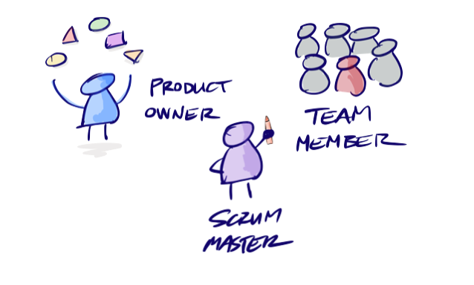
Notes:
Typical Agile team structure; in the classical sense. Roles included as ‘Team Members’.

Slide 13
Notes:
Where is the BA?? Does this mean that one does not exist in the world of Agility?

Slide 14
Notes:
Not sure where you got the picture, Jack, but I agree with the sentiment!

Slide 15
Notes:
Agility BAs wear many hats!

Slide 16
Notes:
Coordinator
Researcher
Mediator
Shadow Product Owner
Technical Writer
Gopher
Scrum Master
Tester

Slide 17
Agile Continuum
Sort of Agile
Pretty Agile
Not Agile
Somewhat Agile
Absolute Agile
Notes:
Agile is not binary! The implementation depends on the organization.

Slide 18
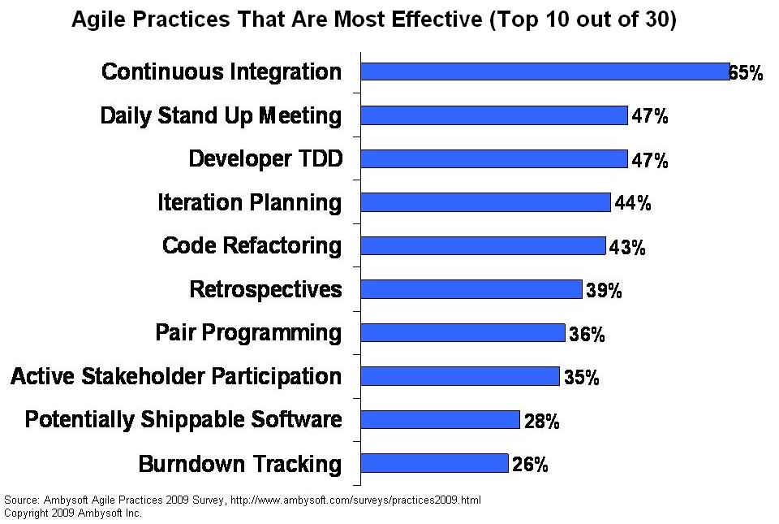

Slide 19
WATerfall
Scrumban
Scrum
Scrummerfall
Kanban
Notes:
Types of SDLC Implementations

Slide 20
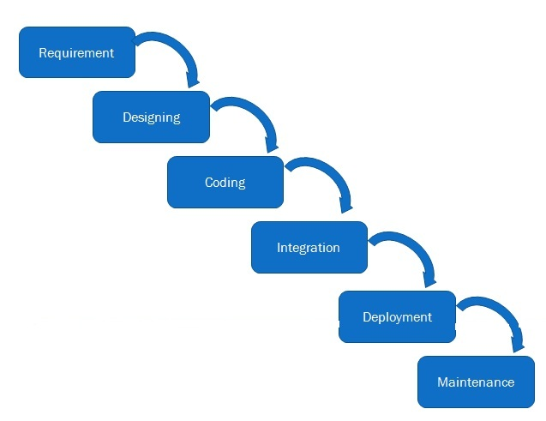
WATerfall
Notes:
Each step complete before moving forward. Ordering a Pizza.

Slide 21
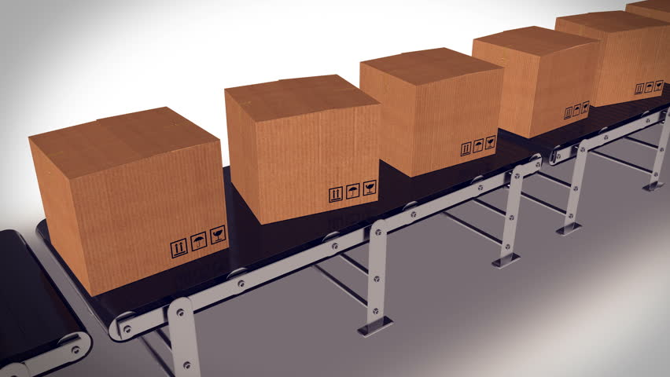
Scrum
Notes:
Iterative development. Concise planning. Set teams. Ceremonies on a strict cadence.

Slide 22
Scrummerfall
Notes:
Waterfall Development broken up into iterations.
Or
Waterfall cycle within a sprint

Slide 23
Kanban
Notes:
No precise planning. WIP limits are critical. Roles as needed. No formal ceremonies.

Slide 24
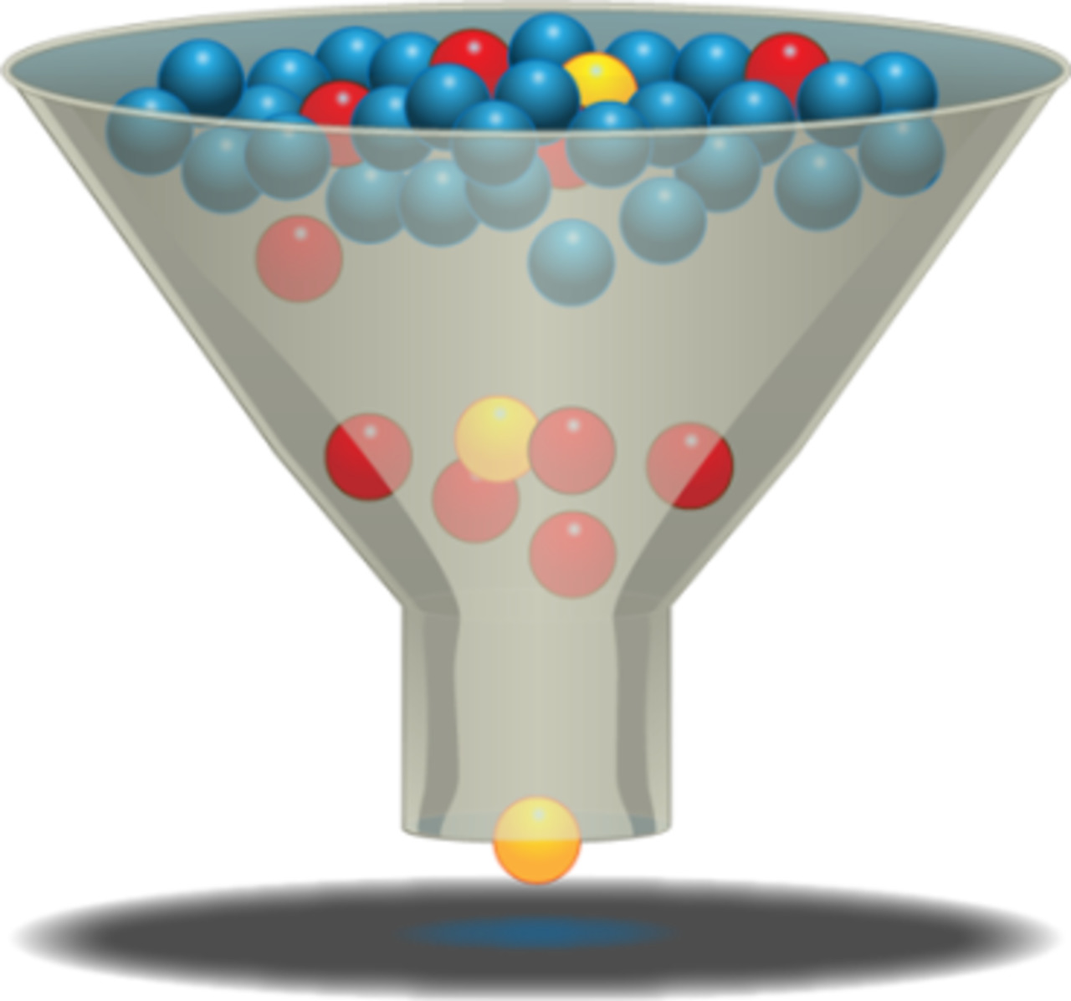
Scrumban
Notes:
Similar to Kanban, but with roles, planning and ceremonies.

Slide 25
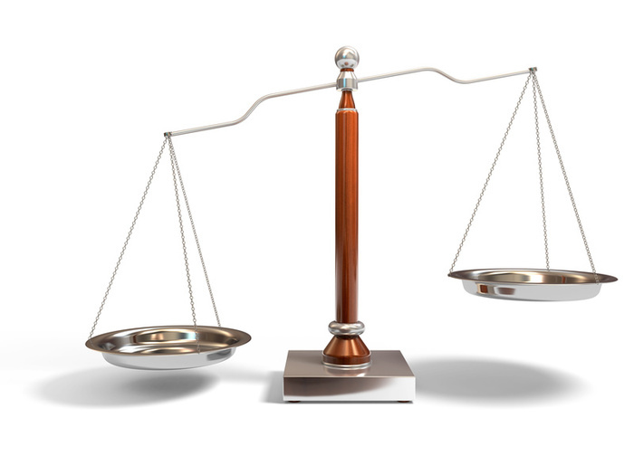
Notes:
Which is better?

Slide 26
It Depends!

Slide 27
Notes:
Project followed the classic Scrum model. Rinse and repeat!

Slide 28
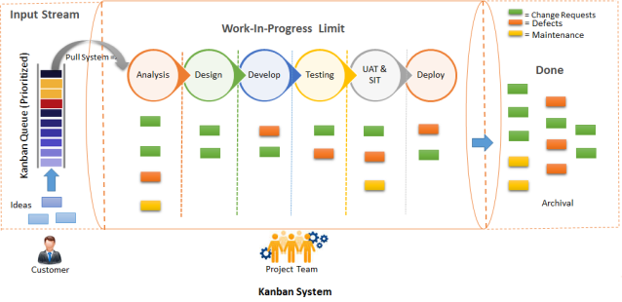
Notes:
Not these exact stages. Note mix of work.

Slide 29
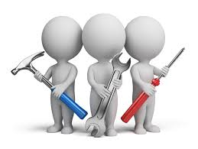
VS.

Slide 30
Pitfalls of Each

Slide 31
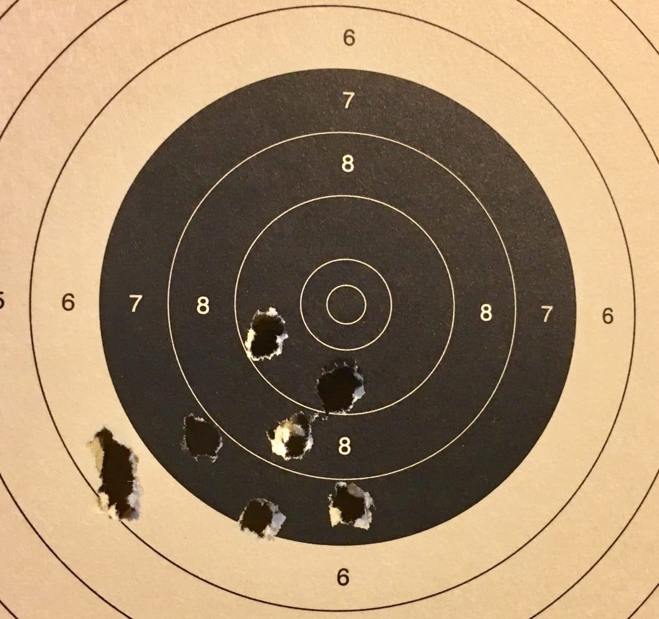
Notes:
Scrum: Inaccurate Estimates

Slide 32
Notes:
Scrum: Warp Speed Changes

Slide 33
Notes:
Scrum is time boxed; Kanban and Scrumban is not.
Can lead to:

Slide 35
Notes:
If you aren’t careful, this evolves into this!

Slide 36
While you’re at it!

Slide 37
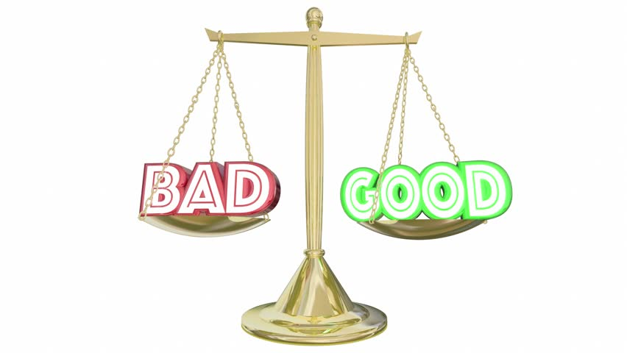

Slide 38
It Depends!

Slide 39
Notes:
So, does that mean ‘Full speed ahead’?

Slide 40
Just because you can, doesn’t mean you should!!

Slide 42
Scrum

Slide 43
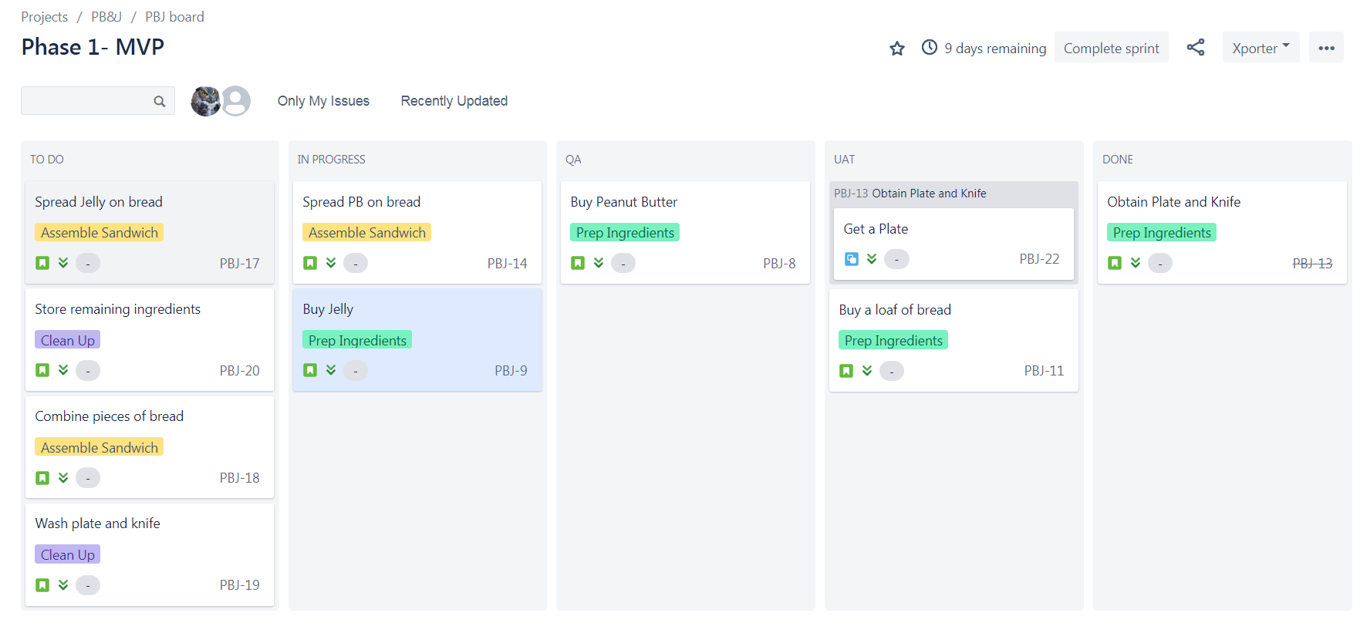
Scrum

Slide 44
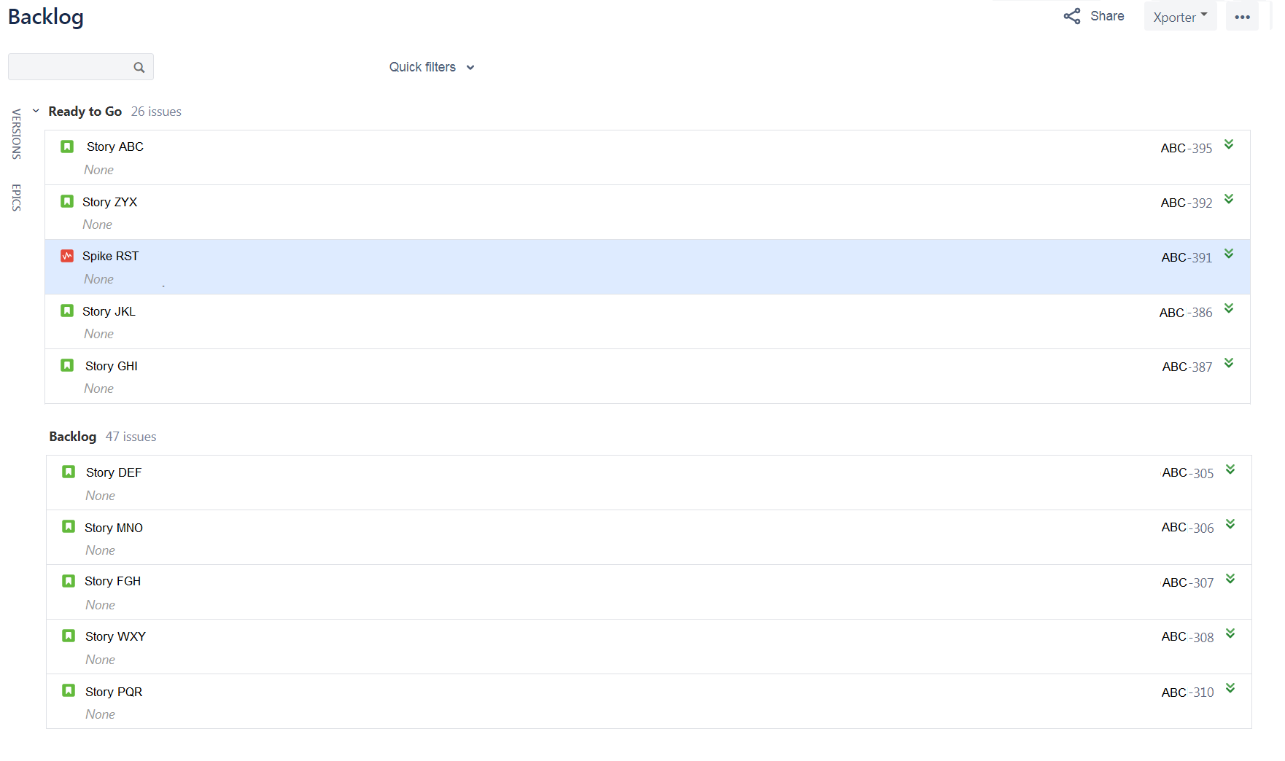
Scrumban

Slide 45
Scrumban

Slide 47
Notes:
Complete/concise/accurate stories
Flexibility to adapt to the team norms
Perform tasks as needed by the team
Be mindful of Scope Creep

Slide 50
It Depends
The team is more of a factor than the Agile implementation
Just be a good BA!!

Slide 51
OK,
I guess you DO know Jack!

Slide 52
Goodbye!!!

