Slide 1
Impact Mapping
Jenny Bentley
Notes:
Kyle

Slide 2

Today’s Focus
Overview of Impact Mapping
How to Measure
Putting it to Practice
Making It Visual
Lessons Learned
Quickie
Scooter
Company

Slide 3
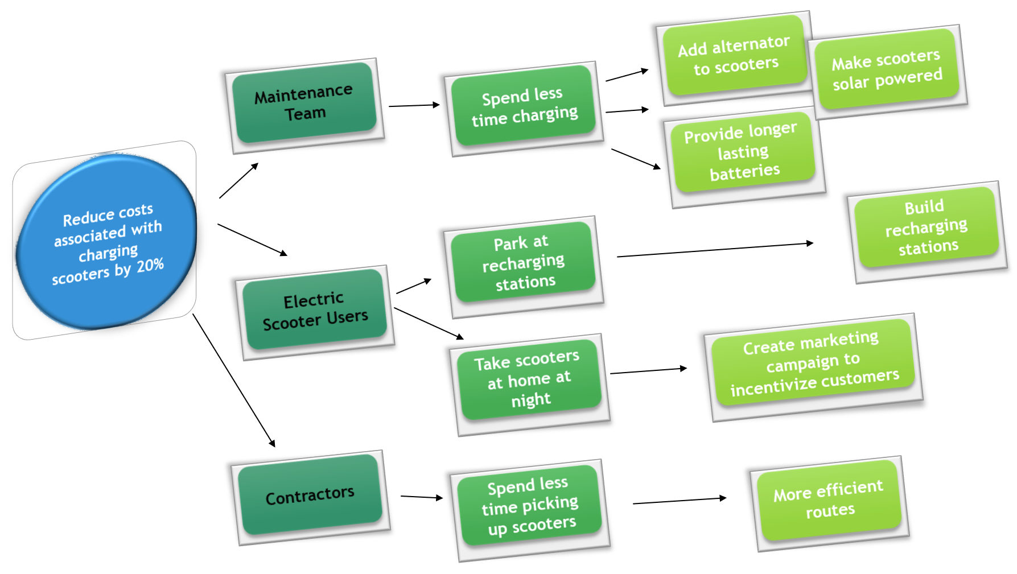


What is Impact Mapping
Outcome
(Goal Based)
Visual
Collaborative
An impact map is a goal-based visualization of scope to help teams align to business objectives
Find the shortest path to the goal!

Slide 4

Scope Based Delivery Model vs.
Outcome Based Delivery Model
Outcome Based
Focused on desired outcome
Success is delivery of minimum amount of functionality needed to achieve the outcome
Incremental measurements to determine viability of solution
Scope Based
Focused on predefined list of features
Success through implementation of all scope regardless of when goal is achieved
Measurements after the fact and difficult to determine which feature had the most impact

Slide 5
When to Use
Refinement
Delivery
Discovery
Design Thinking
Purpose
Prioritize and begin scope decomposition
Purpose
Understand and validate customer and business problem
User Stories
Impact Mapping
Purpose
Deliver working software to customers

Slide 6
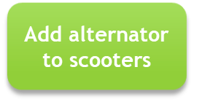


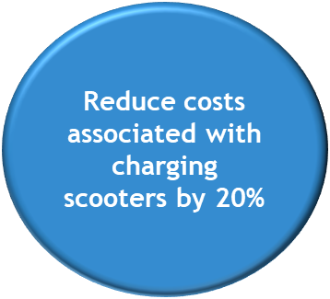
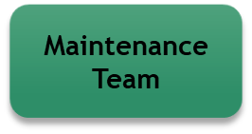
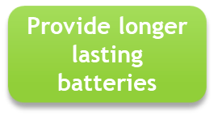

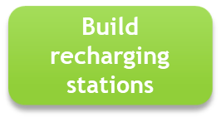
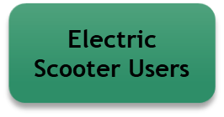
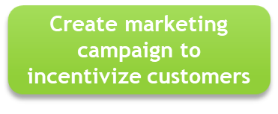

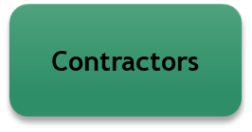
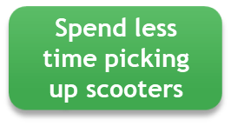
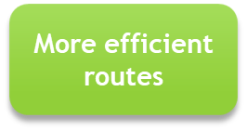
Four Components of an Impact Map
Outcome/Goal:
The Why
Actors:
The Who
Impacts:
The How
Behavior Change
Deliverables: The What
Quickie
Scooter
Company

Slide 7

Breaking it Down
Deliverables: The What
Options
Options
Options
Pre-map the routes with technology
Install tracking devices on scooters
Create communication plan
Create service areas into zones
Determine best times to travel
Adjust routes to cover less area

Slide 8
Measuring the Outcome
Impacts:
The How
Behavior Change
Deliverables: The What
Actors:
The Who
Benchmark
Contractor Reduction
20 Contractors
Milestone
2 months
Minimum Acceptable Value
16 Contractors
Target Value
14 Contractors
Metric
Goal/Outcome:
The Why

Slide 9
Achieving the Outcome
Reduce Contractors from 20 to 14
Options
Options
Benchmark
20
Install tracking devices on scooters
Pre-map the routes with technology
20
Rethink Strategy
20
19
19
Target
14
15
17
16
Contractor Count
13
10
5
Months
0
1
2
3
4
5
9

Slide 10

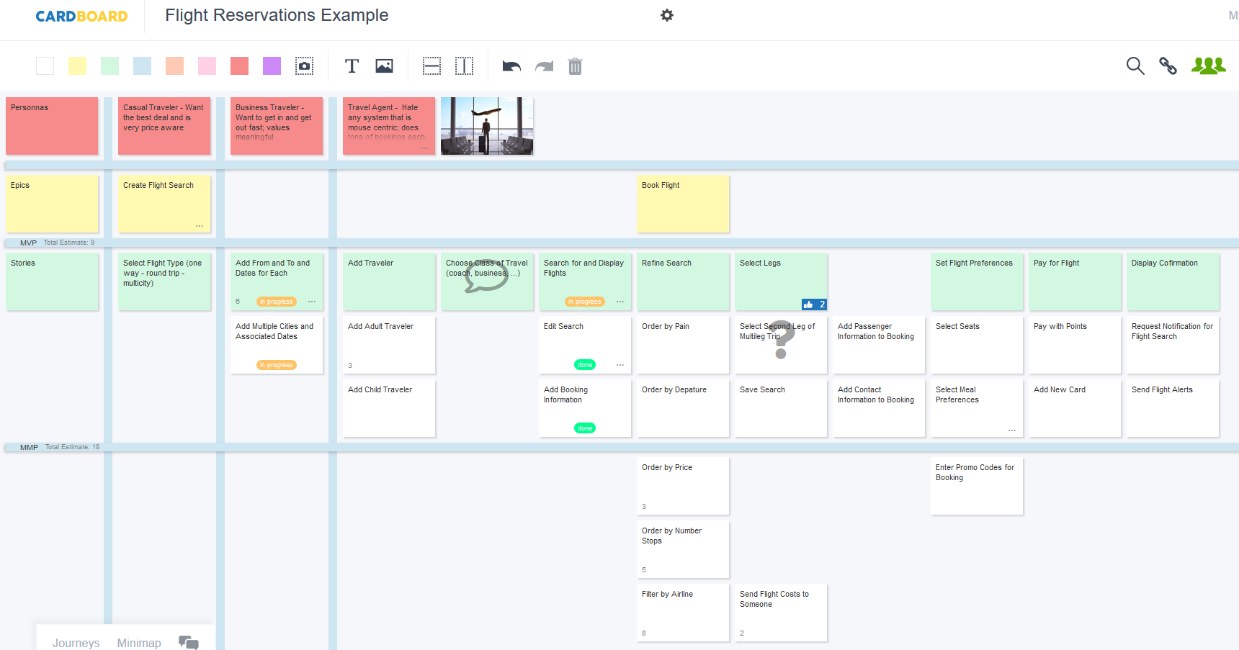
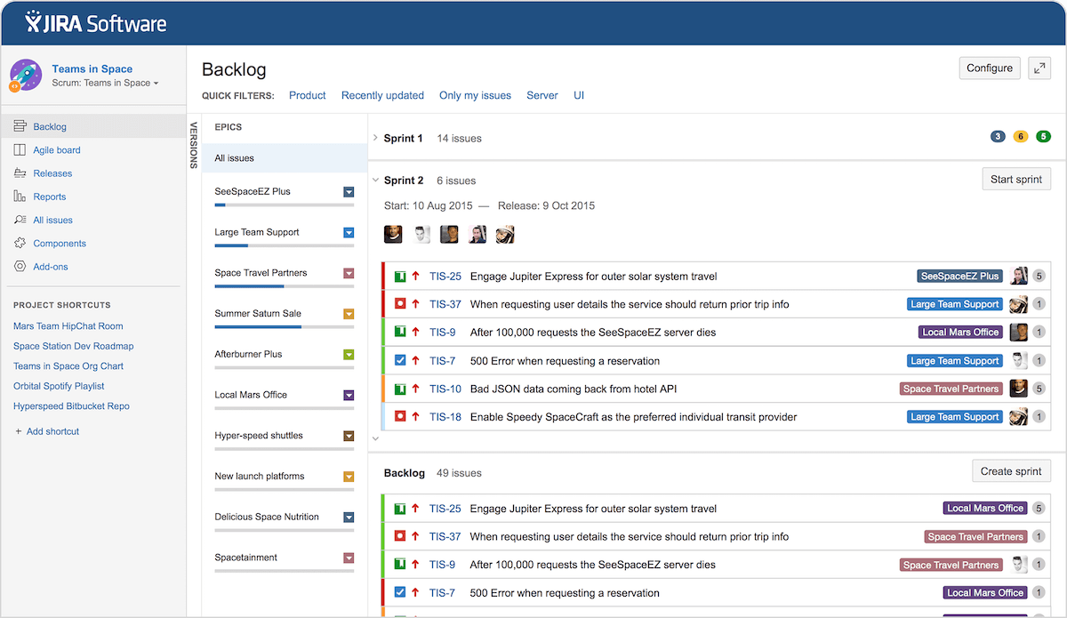
Making It Visual
In the spirit of the aspirational goals to reduce IT delivery time and to provide our associates with tools to enable speed of business value delivery, we are integrating the use of visualization tools into the requirements decomposition process.
  Visualization of scope to expedite the decomposition process
  Allow active participation by all participants regardless of location
  Expedite the decisioning/prioritization of MVPs and MMPs by visualizing the delivery
  Integration with Jira and GitHub to eliminate hand offs
  Alignment and standardization of requirements terminology with industry standard tool sets
Impact Mapping
Strategic Planning technique for goal-oriented requirements engineering that supports frequent iterative delivery, agile and lean software methods product development cycles and design thinking.
Story Mapping
Technique to visualize the entire product or service as a series of tasks which the user completes. Goal is to discover requirements from a user experience point of view. Collaborative exercise to transform the approach from requirements delivery to requirements discovery.
Agile Lifecycle Management Tool (JIRA)
Integration of Story Mapping tool with Agile Lifecycle Tool to enable continuous flow of requirements and eliminate hand-offs.

Slide 11
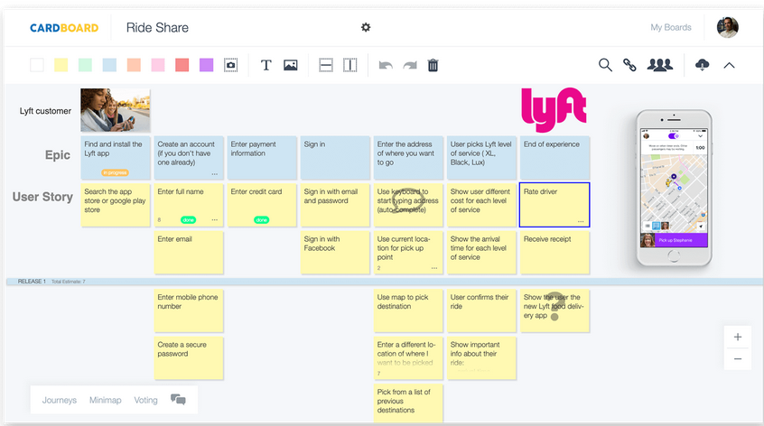
Making It Visual with Cardboard
- Visualization tool with 9 templates
  Templates
    Bullseye Chart
    Business Model Canvas
    Freeform Canvas
    Opportunity Canvas
    Simple Kanban Board
    Start, Stop Continue Retro
    Swim Lane Kanban
    The 4L’s Retrospective
    User Story Map
- Access types
  Collaborator – can create and contribute to a board
  Viewer – read only access
- Integrates with Jira and GitHub
- Goal to expedite requirements decomposition process through visualization

Slide 12
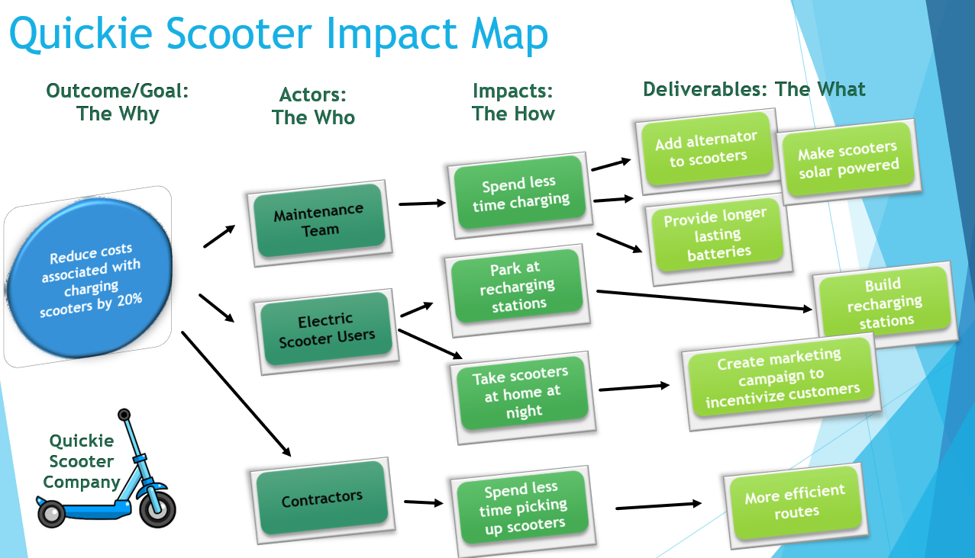
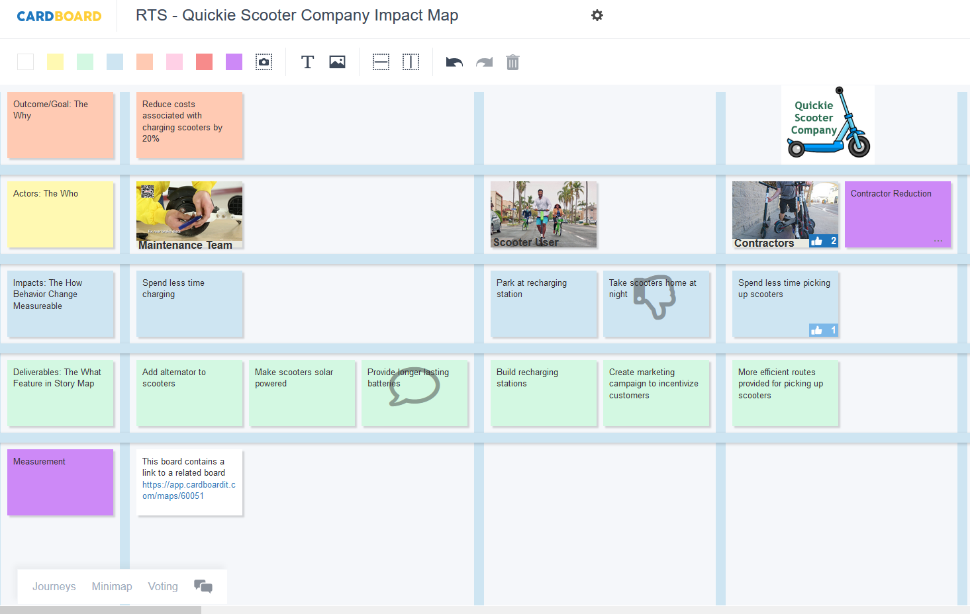
Putting it to Practice – Impact Map

Slide 13
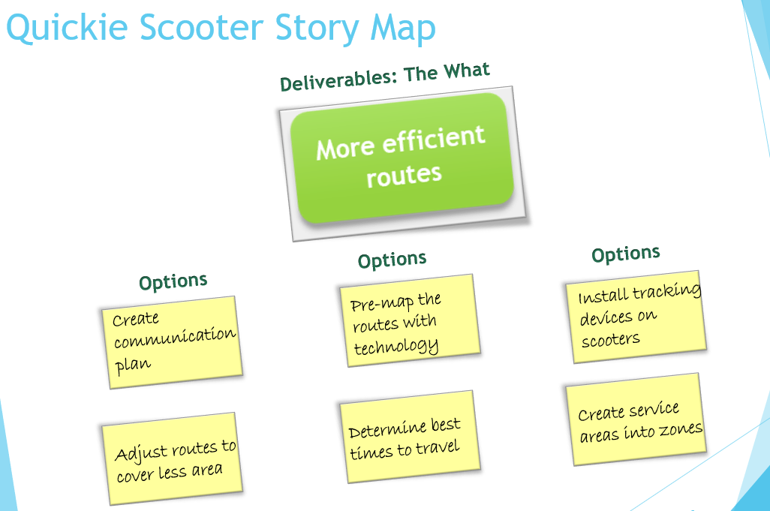
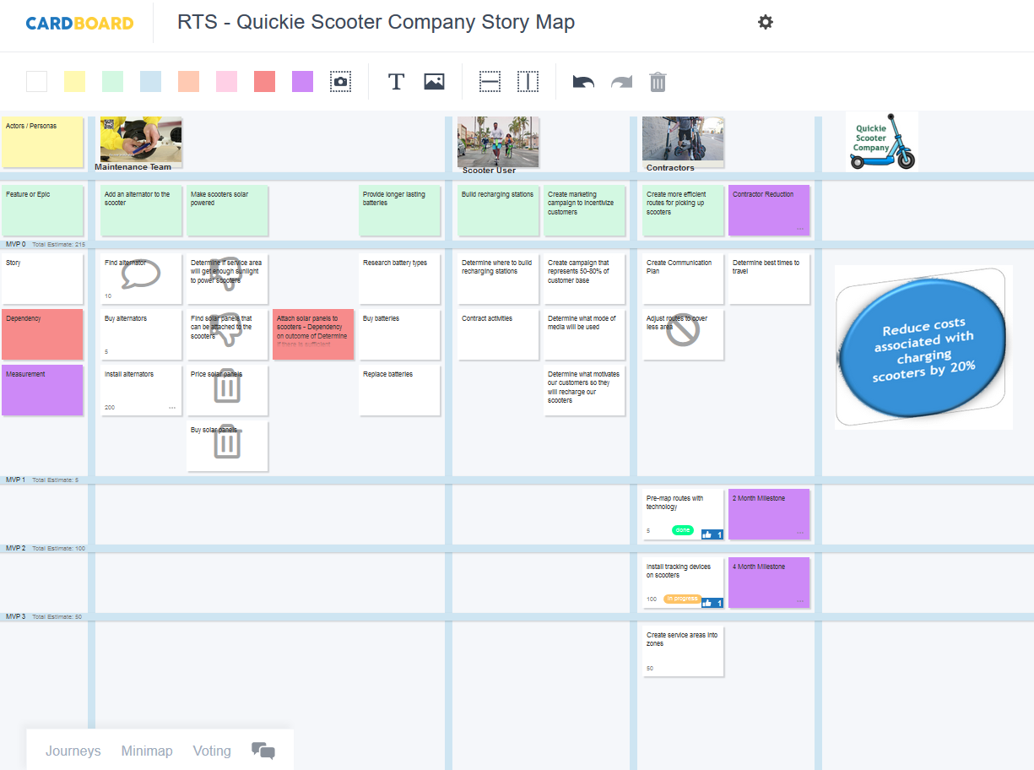
Putting it to Practice – Story Map

Slide 14
Lessons Learned
Mindset Shift
Bias to identify solutions before defining desired behavior changes
Evaluate all options, not all options necessary to achieve the goal require technical solutions
Focus on shortest path to the goal
Metrics, Metrics, Metrics
Be specific, determine what, how and over what time
Establish benchmark, create it if one does not exist
Measure incremental progress

Slide 15

Benefits
Collaborative
Outcome (Goal Based)
Visual
Measure
Find the shortest path through the map to the outcome!
Notes:
Encourages us to take the shortest path to the goal
Visualization of scope allows us to focus on the conversation and expediate the decomposition of scope
Empowers those doing the work to make decisions
Aids in prioritization
Helps in decision making.
We build, then measure and validate and determine next steps

Slide 16
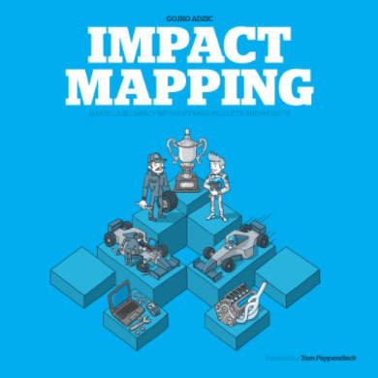


Resources
Website:
Cardboardit.com
Impact Mapping
by Gojko Adzic
a Seat at the Table
By Mark Schwartz
Chapter 5 Requirements
Website:
ImpactMapping.org
Notes:
Podcasts
https://castbox.fm/app/castbox/player/id2682/id382123
https://castbox.fm/app/castbox/player/id28527/id2366652
Videos
The art of Impact Mapping
Articles
https://www.agileconnection.com/article/problem-solving-impact-mapping
https://opensource.com/open-organization/17/6/experiment-impact-mapping
https://www.impactmapping.org/
https://visualonepagers.com/wp-content/uploads/catablog/originals/ImpactMapping.png

Slide 17
Resources
https://castbox.fm/app/castbox/player/id2682/id382123
https://castbox.fm/app/castbox/player/id28527/id2366652
The art of Impact Mapping
https://www.youtube.com/watch?v=y4Rj05YVg_E
https://www.agileconnection.com/article/problem-solving-impact-mapping
https://opensource.com/open-organization/17/6/experiment-impact-mapping
https://www.impactmapping.org/
https://visualonepagers.com/wp-content/uploads/catablog/originals/ImpactMapping.png
https://uxpressia.com/blog/build-impact-map-4-easy-steps
Impact Mapping:
Podcasts
Videos
Articles
Notes:
Podcasts
https://castbox.fm/app/castbox/player/id2682/id382123
https://castbox.fm/app/castbox/player/id28527/id2366652
Videos
The art of Impact Mapping
Articles
https://www.agileconnection.com/article/problem-solving-impact-mapping
https://opensource.com/open-organization/17/6/experiment-impact-mapping
https://www.impactmapping.org/
https://visualonepagers.com/wp-content/uploads/catablog/originals/ImpactMapping.png

