Slide 1
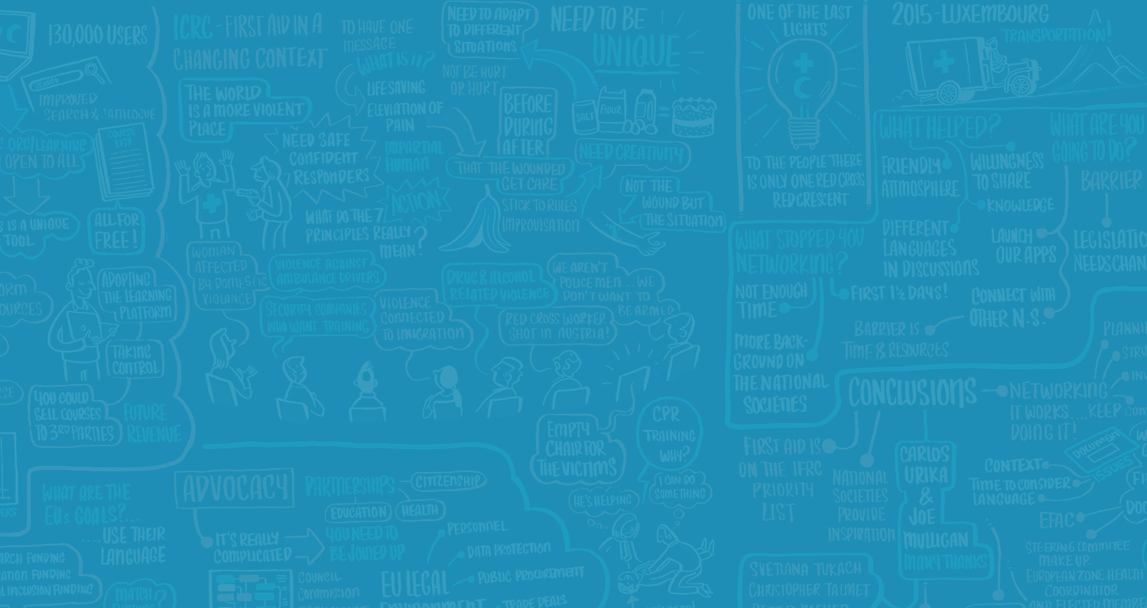

PROCESS FLOWS
WHEN PICTURES SAY IT ALL
By Mindy Bohannon
Agile Analyst, CBAP
@mindybo93
excella.com | @excellaco

Slide 2

Who has created a process flow?
Created a process flow for your current project?
Experience
Comfortable creating at least 3 different types of flows?
Notes:
How many of you created a process flow for your current project? Show of hands
How many of you are comfortable creating at least 3 different types of process flows? Show of hands.
Who are the best people to create process flows for an initiative? BA or SME, together, and then refined by other stakeholders

Slide 3
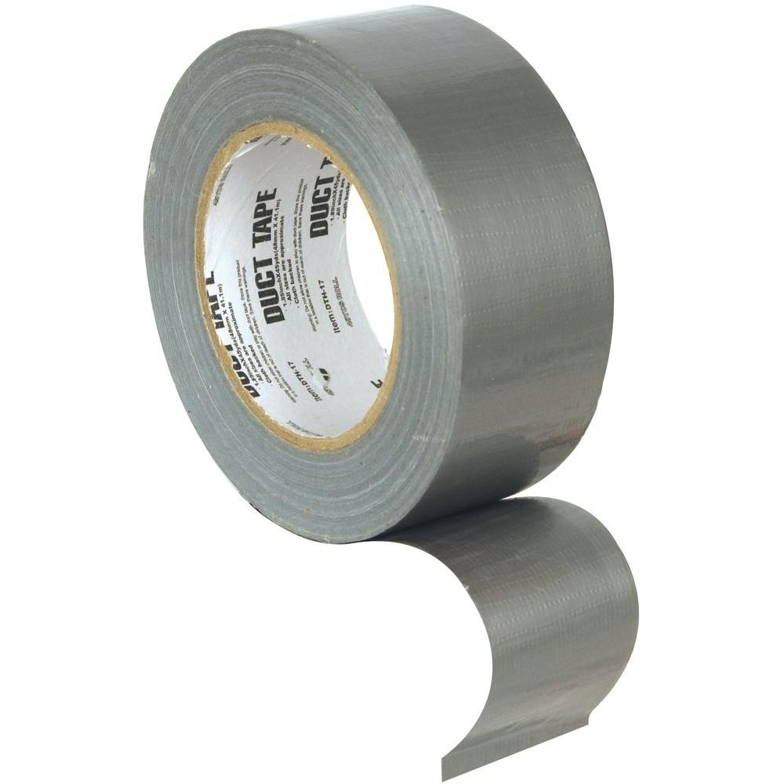

DOES IT MOVE?
YES
NO
SHOULD IT?
SHOULD IT?
NO
YES
YES
NO
NO PROBLEM
Notes:
Review this process flow, is it thorough? How simple is it?

Slide 4
Basic drawing symbols to use
Steps and elements of a good process flow
Benefits and Issues during creation
Intentions
Notes:
What are we doing here?
Who am I to talk to this subject?

Slide 5
Write/Draw the Steps
for Making a
Grilled Cheese Sandwich
Simplest Possible – 5 steps max
Notes:
Create the simplest process flow for this you can think of. Like the stick figure of process flows – at most 3-5 steps
No decisions – we want this grilled cheese sandwich now!

Slide 6
Why Should We Create a Process Flow?
Fix a Problem
Identify complex processes
See where we can reduce time in a process
Ensure everyone understands how the process works
Identify areas not understood
Assist with training documentation
Notes:
A business analyst is often assigned to a project where they may have little to no background on the actual business process they are supposed to analyze.
Carving out time to build a business workflow diagram will not only help with writing meticulous requirements, but will also enlighten stakeholders for more comprehensive requirements farming
The first step in solving a problem is to understand it
each person/stakeholder contains an understanding of part of the business process puzzle.
Creating this artifact early on in the project, will not only better flush out the problem, but will educate the entire project team on their own business process.
Process modeling may also identify any stakeholder groups that may have otherwise been overlooked and provide transparency and clarity to process owners. BABOK 10.35.4.1 and 3.2.6
https://www.batimes.com/articles/the-art-of-the-business-workflow-diagram.html

Slide 7
First Step
What Problem are You Trying to Solve?
Create a Process Flow to Understand the Problem
Identify Stakeholders who care about the problem
Notes:
First step in Solving a Problem is to Understand the Problem
Words in addition to pictures

Slide 8
Write the Problem Statement
for Making Your
Grilled Cheese Sandwich
Notes:
Directions: Add this information to your grilled cheese process flow.

Slide 9
Guaranteed Success?
Definitely Not!
Drawing process flows doesn’t guarantee you’re drawing the right processes.
Draw it from different points of view
Who’s processes are we trying to evaluate and improve?
Notes:
http://360connext.com/process-flows-dont-know-jack/
Draw it from different points of view, the customer, the supplier, the help desk support.

Slide 10
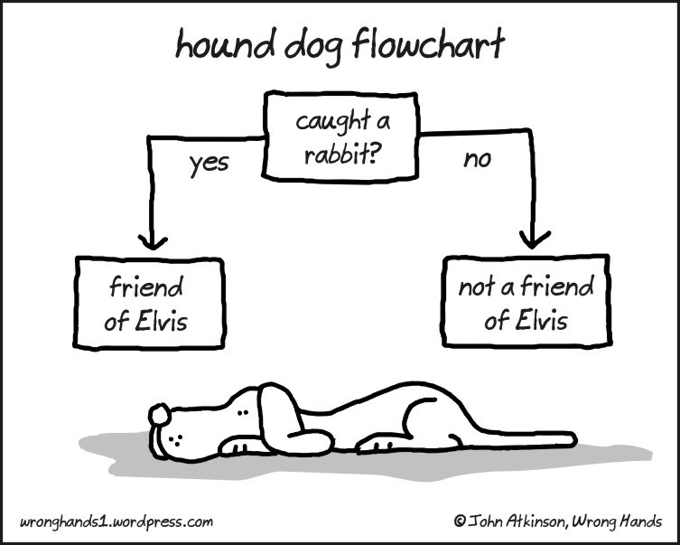

Slide 11
What’s the Difference?
Process Flows
  A diagram commonly used to indicate the general flow of a process
Process Mapping
  Defining what a business entity does, who is responsible, to what standard a process should be completed, and how the success of a process can be determined
Business Process Modeling
  Activity of representing processes of an enterprise, so that the current process may be analyzed or improved.
Notes:
All are very similar yet different.
b. BPM: Business process modeling (BPM) in systems engineering is the activity of representing processes of an enterprise, so that the current process may be analyzed or improved.
c. Process Map: refers to activities involved in defining what a business entity does, who is responsible, to what standard a business process should be completed, and how the success of a business process can be determined. (Wikipedia, https://en.wikipedia.org/wiki/Business_process_mapping) Various graphical descriptions of processes can be useful. These include: detailed flow-charts, work flow diagrams and value stream maps. Each map is helpful depending on the process questions and theories being considered
d. Process Flow: diagram commonly used in chemical and process engineering to indicate the general flow of plant processes and equipment (https://en.wikipedia.org/wiki/Process_flow_diagram) – but we use that term in IT, for non chemical engineering processes
e. Conclusion: This presentation is talking about the basics of process flow diagramming. Not PM and BPM.

Slide 12
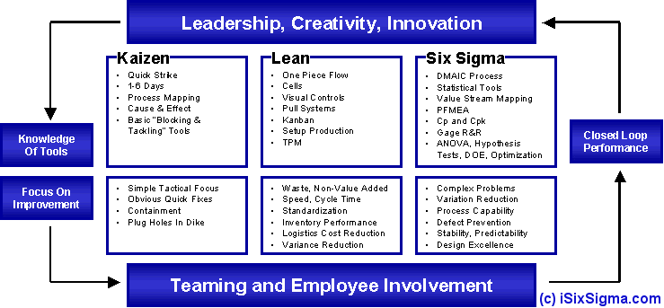
Methodologies that Use Process Flows
Notes:
https://www.isixsigma.com/new-to-six-sigma/how-is-six-sigma-different/six-sigma-lean-or-kaizen-project/
Kaizen – Continuous Improvement

Slide 13
Related Systems that Use Process Flows
Kaizen Events
    Toyota and the New York Soup Kitchen – 90 =>18 mins
Lean, Six Sigma
    Akron Children’s Hospital
Notes:
https://www.isixsigma.com/new-to-six-sigma/how-is-six-sigma-different/six-sigma-lean-or-kaizen-project/
Kaizen – Continuous Improvement
https://www.nytimes.com/2013/07/27/nyregion/in-lieu-of-money-toyota-donates-efficiency-to-new-york-charity.html
Kaizen evaluation created improvements in the process flow for the food pantry packing boxes time (3 minutes down to 11 seconds)
and the time clients spent in line to get a meal/soup kitchen. From 90 minutes down to 18 minutes waiting in line.
Lean - https://goleansixsigma.com/lean/ - to reduce costs and time
http://www.leansixsigmaforgood.com/
Akron Children’s Hospital
-Current inefficiencies in their floor plan
-Need to optimize for all stakeholders: providers, staff, families.
Using lean processes, offices sizes were reduced and additional patient rooms were added.
Lean Six Sigma Process Gives Neurology a New Look
Akron Children’s neurology department began a redesign project 2 years ago that involved all levels of providers, staff, and patient families. The improvement project used kaizen, which focuses on continuous improvement, and was held, in a warehouse to propose a true-to-size floor plan. There were inefficiencies in the floor’s original design and delays in daily operations.
By creating a new layout using Lean processes, office sizes were reduced and additional patient rooms were added.
https://goleansixsigma.com/lean-six-sigma-success-stories-in-the-healthcare-and-medical-industries/
Lean - Trinity Rescue Mission – made policy and procedural changes – participation in their Lifeline program increased, TRM is able to get hundreds more men off the street, more people off food stamps quicker, and more people back into the workforce. Participants in the program, as a result of the Lean analysis, are volunteering in TRM’s many programs which are making those programs more efficient, such as the food bank to feed many more families every week.
Aetna
Aetna CIO Meg McCarthy Brings Disciplined Delivery to Aetna
McCarthy singles out Aetna’s network and data center infrastructure organization in this respect, which operates at a Six Sigma level and, she asserts, has no peer in the health insurance industry. “We run a very cost-efficient infrastructure organization in support of our portfolio of business capabilities,” she says. “We are usually compared to large banks and have outperformed our banking colleagues by over 40 percent in all of the commodity aspects of the benchmarks that we apply annually.”
Affordable Care Act
From Volume to Value: Healthcare Reform Reshapes Delivery Models and Diagnostic Laboratories
With the new Affordable Care Act (ACA), clinical laboratories, doctors’ offices, and hospitals are seeing a large number of new patients. To help eliminate unnecessary testing, provide seamless access to laboratory results throughout the continuum of care, improve the quality of testing, and reduce errors, healthcare provide organizations are opting for Lean Six Sigma principles and connectivity solutions.

Slide 14
Core Icons for Notation
Goal
Ovals
Boxes
Diamonds
Arrows
Notes:
Because I want to get practicing quickly, let’s review some basics.
a. Goal - what is the goal for drawing the process flow? Who will be reading it? What purpose does it serve that person? What level of detail?
b. Flowchart is a primary type of business process mapping.
Detailed flowcharts includes detail, such as the inputs, activities, decision points, and outputs of any process.
c. These symbols come from the Unified Modeling Language or UML, which is an international standard for drawing process maps. (https://www.lucidchart.com/pages/process-mapping/process-map-symbols)
g. Ovals – starter or terminator - Represents the entry and exit points of your flowchart. Usually a flowchart has only one starting point but can have several ending points.
e. Boxes – Process, most frequently used flowchart shape shows an action, task or operation that needs to be done.
f. Diamonds – decision, The point at which a decision needs to be made. The arrows flowing from the decision shape are usually labeled with yes, no, true or false.
h. Arrows - The arrows indicate the direction in which the flowchart should be read (usually from the top to the bottom and/or the left to the right).
Other icons:
d. Circle – connect to another process in another system/flowchart or to another page
(In order to connect to different page or section of the chart, and you can't draw a line, you can use a circle labeled with a letter. Put another circle with the same letter where the flow continues.)
i. Other many other icons: document, manual input, display, database

Slide 15
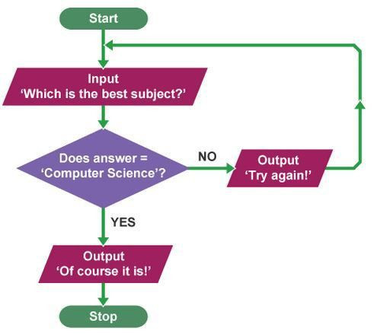
First Step
b
Notes:
Did you use a diamond decision point?

Slide 16
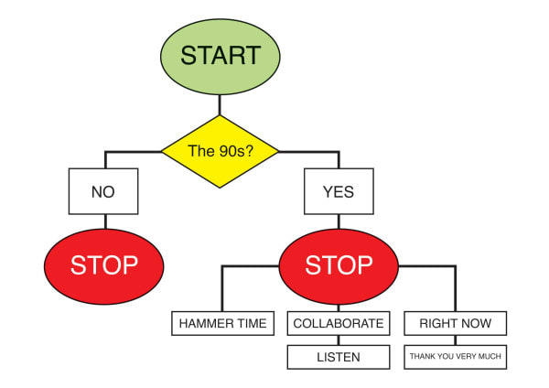
Notes:
Did you use a diamond decision point?

Slide 17
Create One Decision Point in Making Your Grilled Cheese Sandwich
Tweet it to @mindybo93 #mindysCheese
#BACON2019 #meetmeatbacon
Notes:
Use the Diamond icon to create a decision point while making your grilled cheese sandwich?
What problem could you encounter while making this sandwich?
Perhaps its when selecting the bread to use.
Or the type of cheese to use.

Slide 18
Types of Process Flows
AS-IS
Transition
TO-BE
SIPOC
Activity
Data Flow
Activity Diagram
Swim Lanes
Functional
Context
Notes:
Different types of names for process flows
AS-IS – current state
TO-BE – future state
Both are valuable – even more valuable if written for different stakeholders
SIPOC – Supplier, Inputs, Process, Outputs, Customer

Slide 19
Steps to Drawing a Process Flow
  Start - major segments/activity in the flow
  Identify the sequence and flow of the process – add more detail
  Connect activities using arrows
  Finalize (for now) the flow of the process
  Review with stakeholders
  Refine => Repeat for AS-IS and TO-BE

Slide 20
Name Your Stakeholder
to Your Grilled Cheese
Process Flow
Notes:
Add your stakeholder next to the problem statement who will be consuming/reading this grilled cheese sandwich process flow

Slide 21
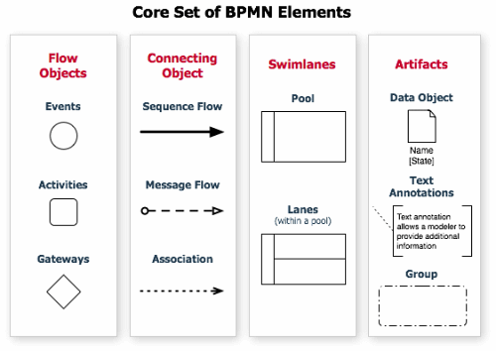
Business Process Modeling Notation
Notes:
Business Process Modeling Notation
Let’s add more detail, can use these more advanced notation symbols

Slide 22
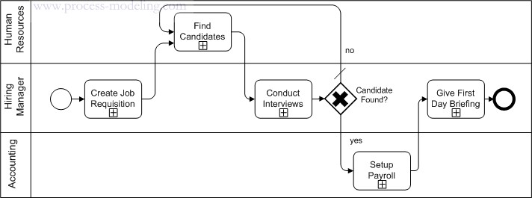
Cross Functional Flow Chart

Slide 23
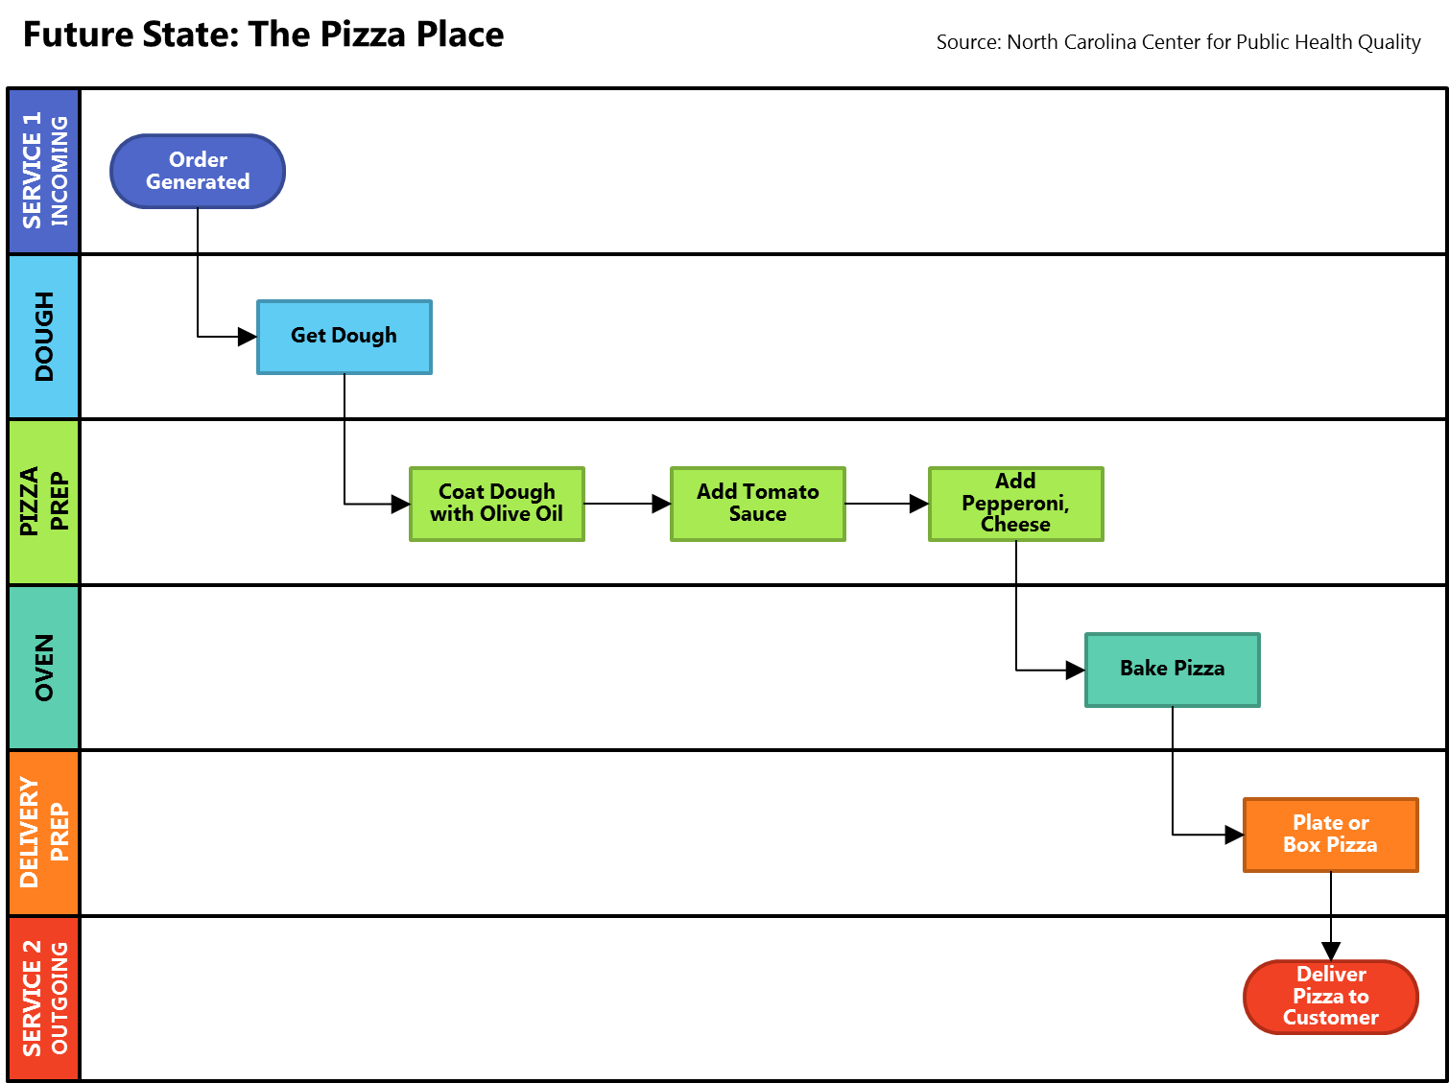

Slide 24
Tools
Visio
MS Word, Powerpoint
draw.io
LucidChart
SmartDraw
Argo
PAPER
Notes:
https://www.quora.com/Whats-the-best-tool-to-build-a-flowchart - lists a ton of tools
Also, PowerPoint, Word

Slide 25
Let’s Do This
Best Grilled Cheese Ever

Slide 26
Add More Details Steps to Making Your Grilled Cheese Sandwich
Tweet it to @mindybo93 #mindysCheese
#BACON2019 #meetmeatbacon
Notes:
Go nuts adding more to your process flow. Remember who your stakeholder is that you’re sharing this with after this session.

Slide 27
Review Your Sandwich Steps
Share Your Grilled Cheese Sandwich Steps
Who has Steps Not Mentioned Yet?
Notes:
Exercise Directions from the Grilled Cheese:
1. Looking at your diagram. Who wants to say their steps?
2. Now, who in the group has identified steps the first person has not listed?
New Exercise:
As a group, identify a process that you are all familiar with that could use a few improvements
Determine audience goal of the process analysis?
Determine level of detail?
What is the objective of the process?
What is the start and end point?

Slide 28
Draw a Process Flow to…
Getting a Coke out of a Vending Machine
  Attend the PM/Business Analyst World Conference?
Make Plans for Brunch with 6 Friends
Notes:
Exercise Directions from the Grilled Cheese:
1. Looking at your diagram. Who wants to say their steps?
2. Now, who in the group has identified steps the first person has not listed?
New Exercise:
As a group, identify a process that you are all familiar with that could use a few improvements
Determine audience goal of the process analysis?
Determine level of detail?
What is the objective of the process?
What is the start and end point?

Slide 29
Leveling Up
Advanced BPMN Techniques

Slide 30
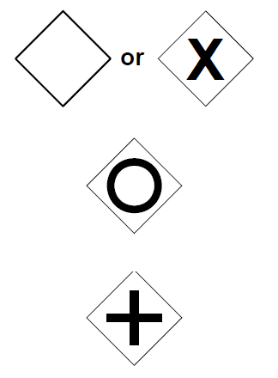
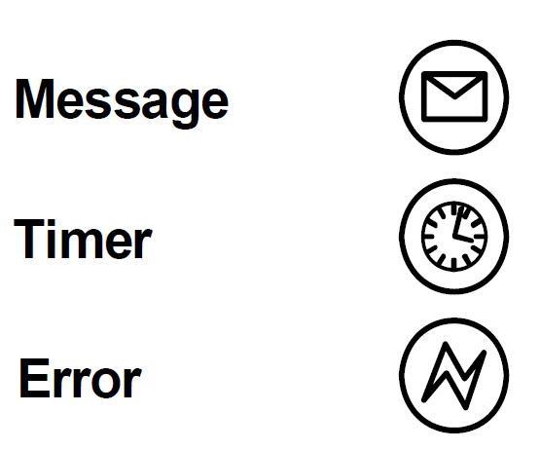
Business Process Modeling Notation
Additional BPMN Elements
Gateways
Events
Exclusive
Message
Timer
Inclusive
Error
Parallel
Notes:
Business Process Modeling Notation
The BPMN specification defines six types of gateways and twelve event types. The subset shown here can describe most scenarios without asking your readers to know the full specification.
Gateways
Exclusive- These are the gateways people are most used to seeing in their process models.
Inclusive- Unlike the Exclusive gateway, inclusive gateways allow for multiple output paths given they meet the condition of that flow.
Parallel- Parallel gateways allow for processes to split into concurrent flows and are also used to indicate if/when the flows converge.
Events
Message- Indicates a communication between two entities. Includes emails, phone calls, texts, spoken word, etc.
Timer- Indicates an amount of time that must pass before proceeding or a date/time when to proceed (eg, Monday at 5pm)
Error- Errors indicate some interruption to the normal process flow.

Slide 31
Parallel Gateways
Notes:
Parallel gateways indicate that all of the outgoing events will occur
Parallel workflows need to have a second parallel gateway when the parallel portion has ended.

Slide 32
Error Flows
Notes:
Error events can be used to indicate alternative flows when a process fails. Because it only requires one shape and one line, using error events can reduce the size of your flow while making them easier to read.
Error paths typically have their own process end event. This helps distinguish between successfully completing the process versus ending because something went wrong.

Slide 33
Timers
Notes:
Timers can be used in the Start event to make it clear when a process starts without needing any additional shapes.

Slide 34
Timers
Notes:
Timers can be used to indicate when an alternative flow will begin.

Slide 35
Empty Swimlanes
Notes:
Blank swimlanes are useful when you want to represent a individual who interacts with the process or a system outside of your sphere of influence.
The communication flow between them can represent spoken word, emails, API requests, or any other form of communication which can be understood by both parties.

Slide 36
References
https://en.wikipedia.org/wiki/Business_process_mapping
https://www.nytimes.com/2013/07/27/nyregion/in-lieu-of-money-toyota-donates-efficiency-to-new-york-charity.html
https://www.batimes.com/articles/the-art-of-the-business-workflow-diagram.html
https://www.lucidchart.com/pages/process-mapping/process-map-symbols
http://360connext.com/process-flows-dont-know-jack/
https://www.6sigma.us/six-sigma-articles/step-by-step-guide-to-process-flow-diagram/

Slide 37

If you can’t draw it then you don’t understand it.
If you can draw it you can communicate it.
@mindybo93
Notes:
If you can’t draw it then you don’t understand it.
If you can draw it you can communicate it.
Any questions? Discussion? Alternate learning methods for someone to improve their ability to draw process flows?

Slide 38
Questions?
Discussion?
@mindybo93
Notes:
If you can’t draw it then you don’t understand it.
If you can draw it you can communicate it.
Any questions? Discussion? Alternate learning methods for someone to improve their ability to draw process flows?

